Slide 1
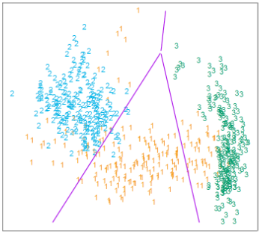
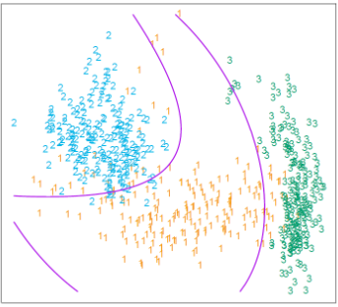
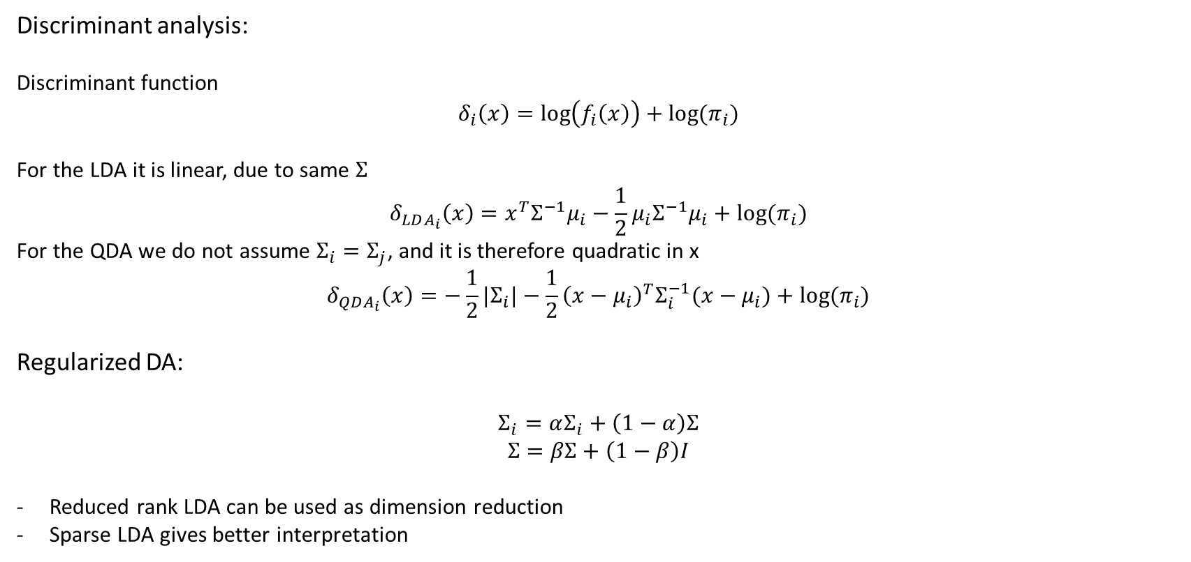
Lecture 4
Discriminant analysis:
Discriminant function
$$δ_{i}\left(x\right)=\log\left(f_{i}\left(x\right)\right)+log⁡(π_{i})$$
For the LDA it is linear, due to same $Σ$
$$δ_{LDA_{i}}\left(x\right)=x^{T}Σ^{−1}μ_{i}−\frac{1}{2}μ_{i}Σ^{−1}μ_{i}+log⁡(π_{i})$$
For the QDA we do not assume $Σ_{i}=Σ_{j}$, and it is therefore quadratic in x
$$δ_{QDA_{i}}\left(x\right)=−\frac{1}{2}{|Σ}_{i}|−\frac{1}{2}{\left(x−μ_{i}\right)}^{T}Σ_{i}^{−1}(x−μ_{i})+log⁡(π_{i})$$
Regularized DA:
$$Σ_{i}=αΣ_{i}+\left(1−α\right)Σ$$
$$Σ=βΣ+\left(1−β\right)I$$
Reduced rank LDA can be used as dimension reduction
Sparse LDA gives better interpretation

Slide 2
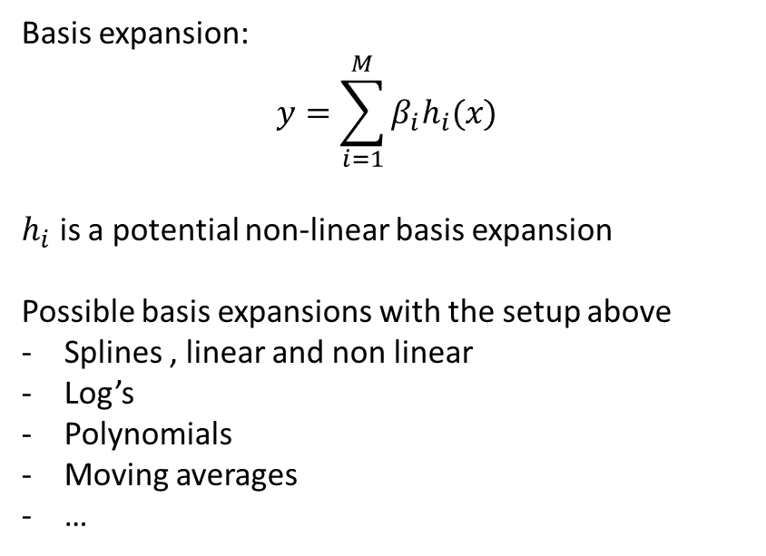
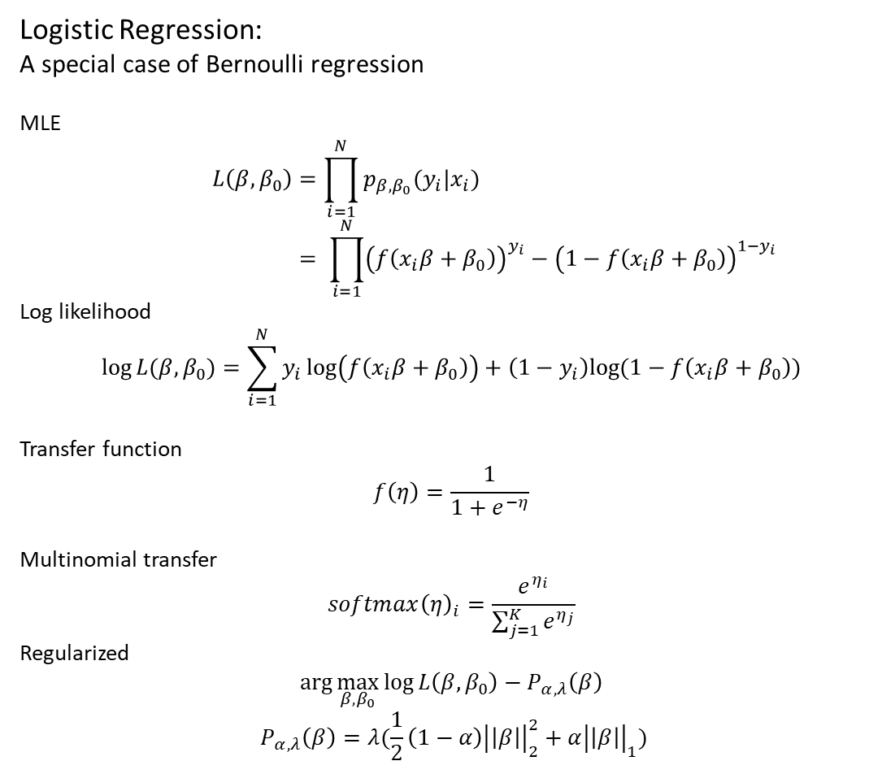
Lecture 4
Logistic Regression:
A special case of Bernoulli regression
MLE
$$L\left(β,β_{0}\right)=\prod_{i=1}^{N}{p_{β,β_{0}}(y_{i}|x_{i})} \\ = \prod_{i=1}^{N}{{\left(f\left(x_{i}β+β_{0}\right)\right)}^{y_{i}}−{\left(1−f\left(x_{i}β+β_{0}\right)\right)}^{1−y_{i}}}$$
Log likelihood
$$\log{L(β,β_{0})}=\sum_{i=1}^{N}{y_{i}\log\left(f\left(x_{i}β+β_{0}\right)\right)+\left(1−y_{i}\right)log⁡(1−f\left(x_{i}β+β_{0}\right))}$$
Transfer function
$$f\left(η\right)=\frac{1}{1+e^{−η}}$$
Multinomial transfer
$$softmax{\left(η\right)}_{i}=\frac{e^{η_{i}}}{\sum_{j=1}^{K}{e^{η_{j}}}}$$
Regularized
$$\arg{\max_{β,β_{0}}{\log{L\left(β,β_{0}\right)−P_{α,λ}\left(β\right)}}}$$
$${ P}_{α,λ}\left(β\right)=λ(\frac{1}{2}\left(1−α\right){\left|\left|β\right|\right|}_{2}^{2}+α{\left|\left|β\right|\right|}_{1})$$
Basis expansion:
$$y=\sum_{i=1}^{M}{β_{i}h_{i}(x)}$$
$h_{i}$ is a potential non-linear basis expansion
Possible basis expansions with the setup above
Splines , linear and non linear
Log’s
Polynomials
Moving averages
…

